Slide 1

IOT-BASED GAS LEVEL DETECTION AND AUTOMATED BOOKING SYSTEM WITH SMOKE DETECTION
JAWAHARLAL NEHRU TECHNOLOGICAL UNIVERSITY KAKINADA
UNIVERSITY COLLEGE OF ENGINEERING NARASARSOPET
ELECTRONICS AND COMMUNICATION ENGINEEERING
PROJECT SUPERVISOR
Mr. Ch. Krishnarao Yadav Assistant Professor(c) Dept of ECE
UCEN- JNTUK
PROJECT ASSOCIATES (Batch-6)
21031A0441 – N. C. Sekhar Reddy
21031A0446 – P. Sathvika
21031A0403 – A. Amrutha
21031A0402 – A. Vikash

Slide 2
CONTENTS
INTRODUCTION
EXISTING METHODS(literature survey)
PROPOSED METHOD
BLOCK DIGRAM
COMPONENTS
FLOW CHART
RESULTS
REFERENCES

Slide 3
INTRODUCTION
The primary goal of the project is to detect gas level of LPG cylinders , which are commonly used in Indian homes.
This project deals with finding the level of the gas in the cylinder and sending the information for booking of a new LPG cylinder when the gas is low , as well as sending an alert to the users using IoT.
MQ6 LPG gas sensor is utilized as input for detecting leakages and sending alert notifications to the user and Load cell assists with automatic LPG booking.
If a fire occurs , the system sends the alert to the user through the mobile with SMS notification.

Slide 4
EXISTING METHODS(literature survey)
PAPER1: Gas Leakage Detection System for Industrial Plants using IoT:
The most of the industrial fires are caused by gas leaks. These have terrible consequences for the equipment, human life (injuries and deaths), and the environment. Leakage detectors that are now available use on-site alarms to warn individuals nearby. As a result, this idea offers a leakage detector that sends an SMS warning to those who are worried. The presence of dangerous gases, such as LPG, Methane, and Benzene, is detected by this detector.
LPG and Methane gases can catch fire, resulting in explosions. If inhaled in high enough concentrations, benzene is a carcinogen that can harm workers' health. As a result, detecting these gases is critical.

Slide 5
PAPER 2: Detection and Location Identification System for Pipeline Gas Leakage:
Every minor task on this globe is automated by the cyberspace of belongings, making our lives easier. The internet of things is now being used for security purposes as well. The main issue today is the discharge of gas from pipelines. The primary mental goal of this research is to identify gas leaks in the pipeline. Again and again, gas detection sensors will be utilized to inspect the pipelines, If there is a leak in the pipeline, it will be detected, and information such as the name of the gas, its pressure rate, and the location of the leak will be sent to mobile phones, laptops, and other IOT devices.

Slide 6
PROPOSED METHOD
Gas level sensing and automation booking are created with a variety of features that are implemented using Arduino UNO , and this device will serve as a single system with different applications for LPG consumers.
The device keeps track of the gas level of LPG Cylinder and displays it in the LCD Dispaly. It also uses a gas sensor to detect gas leaks, and if one is detected, the buzzer is activated and the user is notified through SMS.
This includes the feature of ordering a new LPG cylinder if the gas level drops below the pre-defined threshold level. After that , it sends alert to the user.

Slide 7
BLOCK DIAGRAM
Power
supply
Load Cell
HX711 Amplifier
Arduino UNO
Board
GSM A7670C
MQ6 gas sensor
LCD Display
Fire sensor
Buzzer

Slide 8
COMPONENTS
Hardware Requirements:
Arduino UNO board
Load cell
MQ6 gas sensor
LCD Display
Flame sensor
GSM Module
Power supply 3.3-5V
Jumper wires
Software Requirements:
Arduino IDE

Slide 9

Arduino UNO board:
Arduino Uno board acts as the central control unit, responsible for reading analog signals from a gas sensor (like an MQ-6), interpreting the data to determine the gas concentration, and triggering alerts (like a buzzer or LED) when gas levels exceed a predefined threshold; essentially, the Arduino processes the raw sensor data and translates it into actionable information about the gas level in the environment.

Slide 10
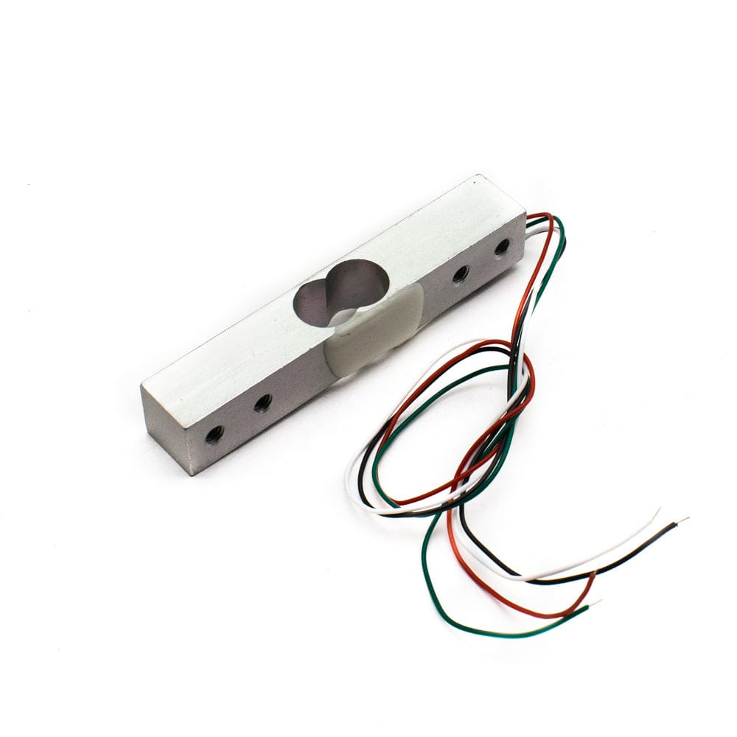
Load cell:
A load cell is a type of transducer that detects force and converts it into an electrical signal. The load cells are employed because they provide precise weight. Most load cells employ a strain gauge to ensure precise measurement.It is utilized to determine the cylinder's weight in this project. The precision is less than 0.1 percent of the total scale.HX711 Amplifier is used to convert analog output of load cell into digital output.

Slide 11
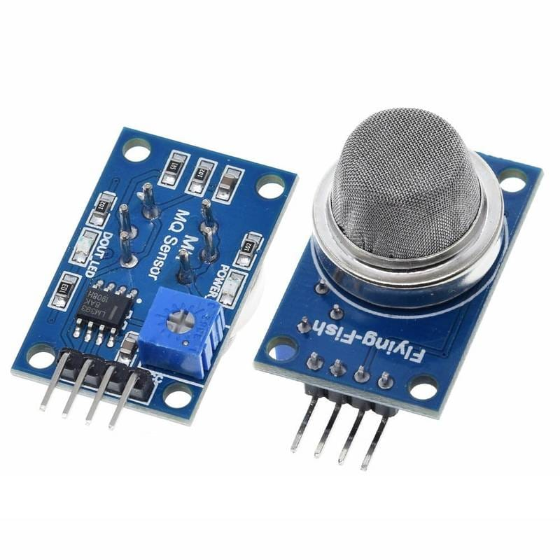
MQ6 gas sensor:
The MQ6 gas sensor is a module that detects gas in the air. There are various different forms of gas, and the gas sensors that the module can identify also differ. The MQ6 gas sensor can detect gases like Methane, Butane, LPG, Smoke, Carbon Monoxide, and other gases. The gas sensor is worked by using an electronic circuit that is delicate to the gas content in the air. Thereby, if gas concentration in the air increases, the output voltage increase, and if the gas concentration in the air decreases, the output voltage decreases.

Slide 12
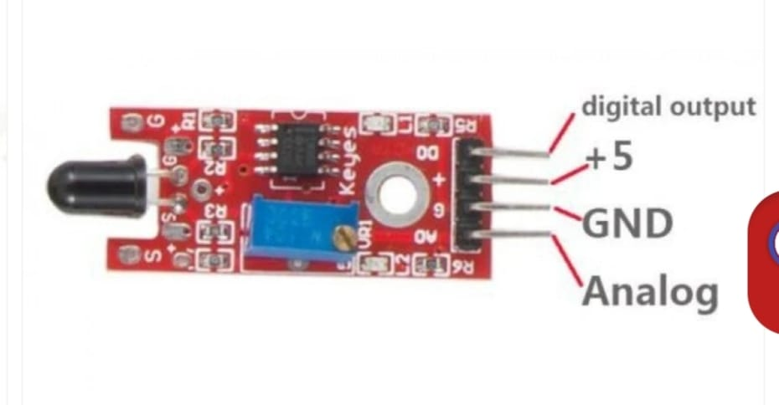
Flame sensor:
Flame sensor module(KY-026 sensor) that includes a flame sensor (IR receiver), resister, capacitor, potentiometer, and LM393 comparator. With this sensor we can detect infrared light with a wavelength between 600 and 900 nanometers.
The light detected in the form of infrared light is converted into current changes by the far-infrared flame probe.
Jumper wires:
Jumper wires are used to connect electrical components,test circuits,and configure printed circuit boards.

Slide 13
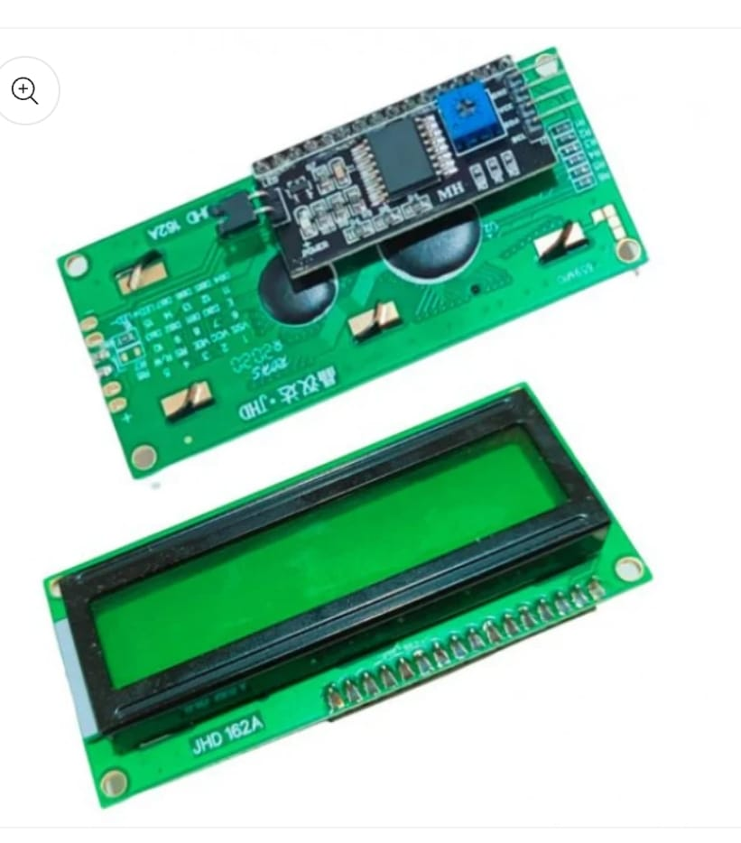
16x2 LCD Display:
→A 16x2 LCD with an I2C interface simplifies wiring by using an I2C adapter (PCF8574), reducing the required connections to just four pins: VCC, GND, SDA, and SCL. It communicates with microcontrollers like Arduino via the I2C protocol, typically using addresses 0x27 or 0x3F. The LiquidCrystal_I2C library allows easy control with functions to initialize, turn on the backlight, and display text. A key advantage of I2C is that it enables multiple devices to share the same bus, making it efficient, scalable, and ideal for compact projects.

Slide 14
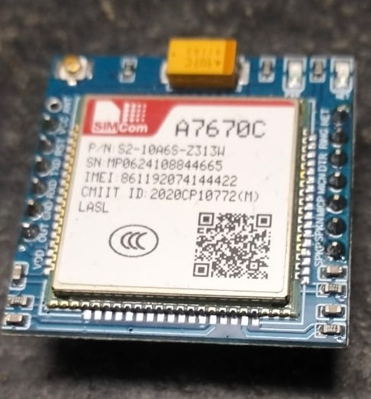
GSM Module
Network Support – The A7670C is a 4G LTE Cat 1 module supporting LTE-TDD, LTE-FDD, GSM, GPRS, and EDGE networks.
Interfaces & Compatibility – It features UART, USB, I2C, and GPIO interfaces, and is compatible with SIM7000/SIM7070 modules for easy migration.
Data Rates & Features – Supports up to 10 Mbps (downlink) and 5 Mbps (uplink), with additional features like FOTA, LBS, and SSL for security and remote updates.
Applications – Ideal for IoT, telematics, surveillance, POS systems, and industrial routers requiring moderate data transfer speeds.
Development Considerations – Works with microcontrollers like Arduino but requires logic level shifting (1.8V logic) and proper power management

Slide 15
FLOW CHART
Start Arduino
Check sensors and load cell outputs
Weight Calculation
If weight <200g
Send SMS to gas agency number for booking
If Fire/Leak is detected
Buzzer
Alert to user

Slide 16
ADVANTAGES
New cylinder is booked automatically when the gas level is below the pre-defined threshold level and also sends alert to the user through SMS.
If any gas leakage or smoke is detected by the MQ-6 sensor GSM sends alert to the user.

Slide 17
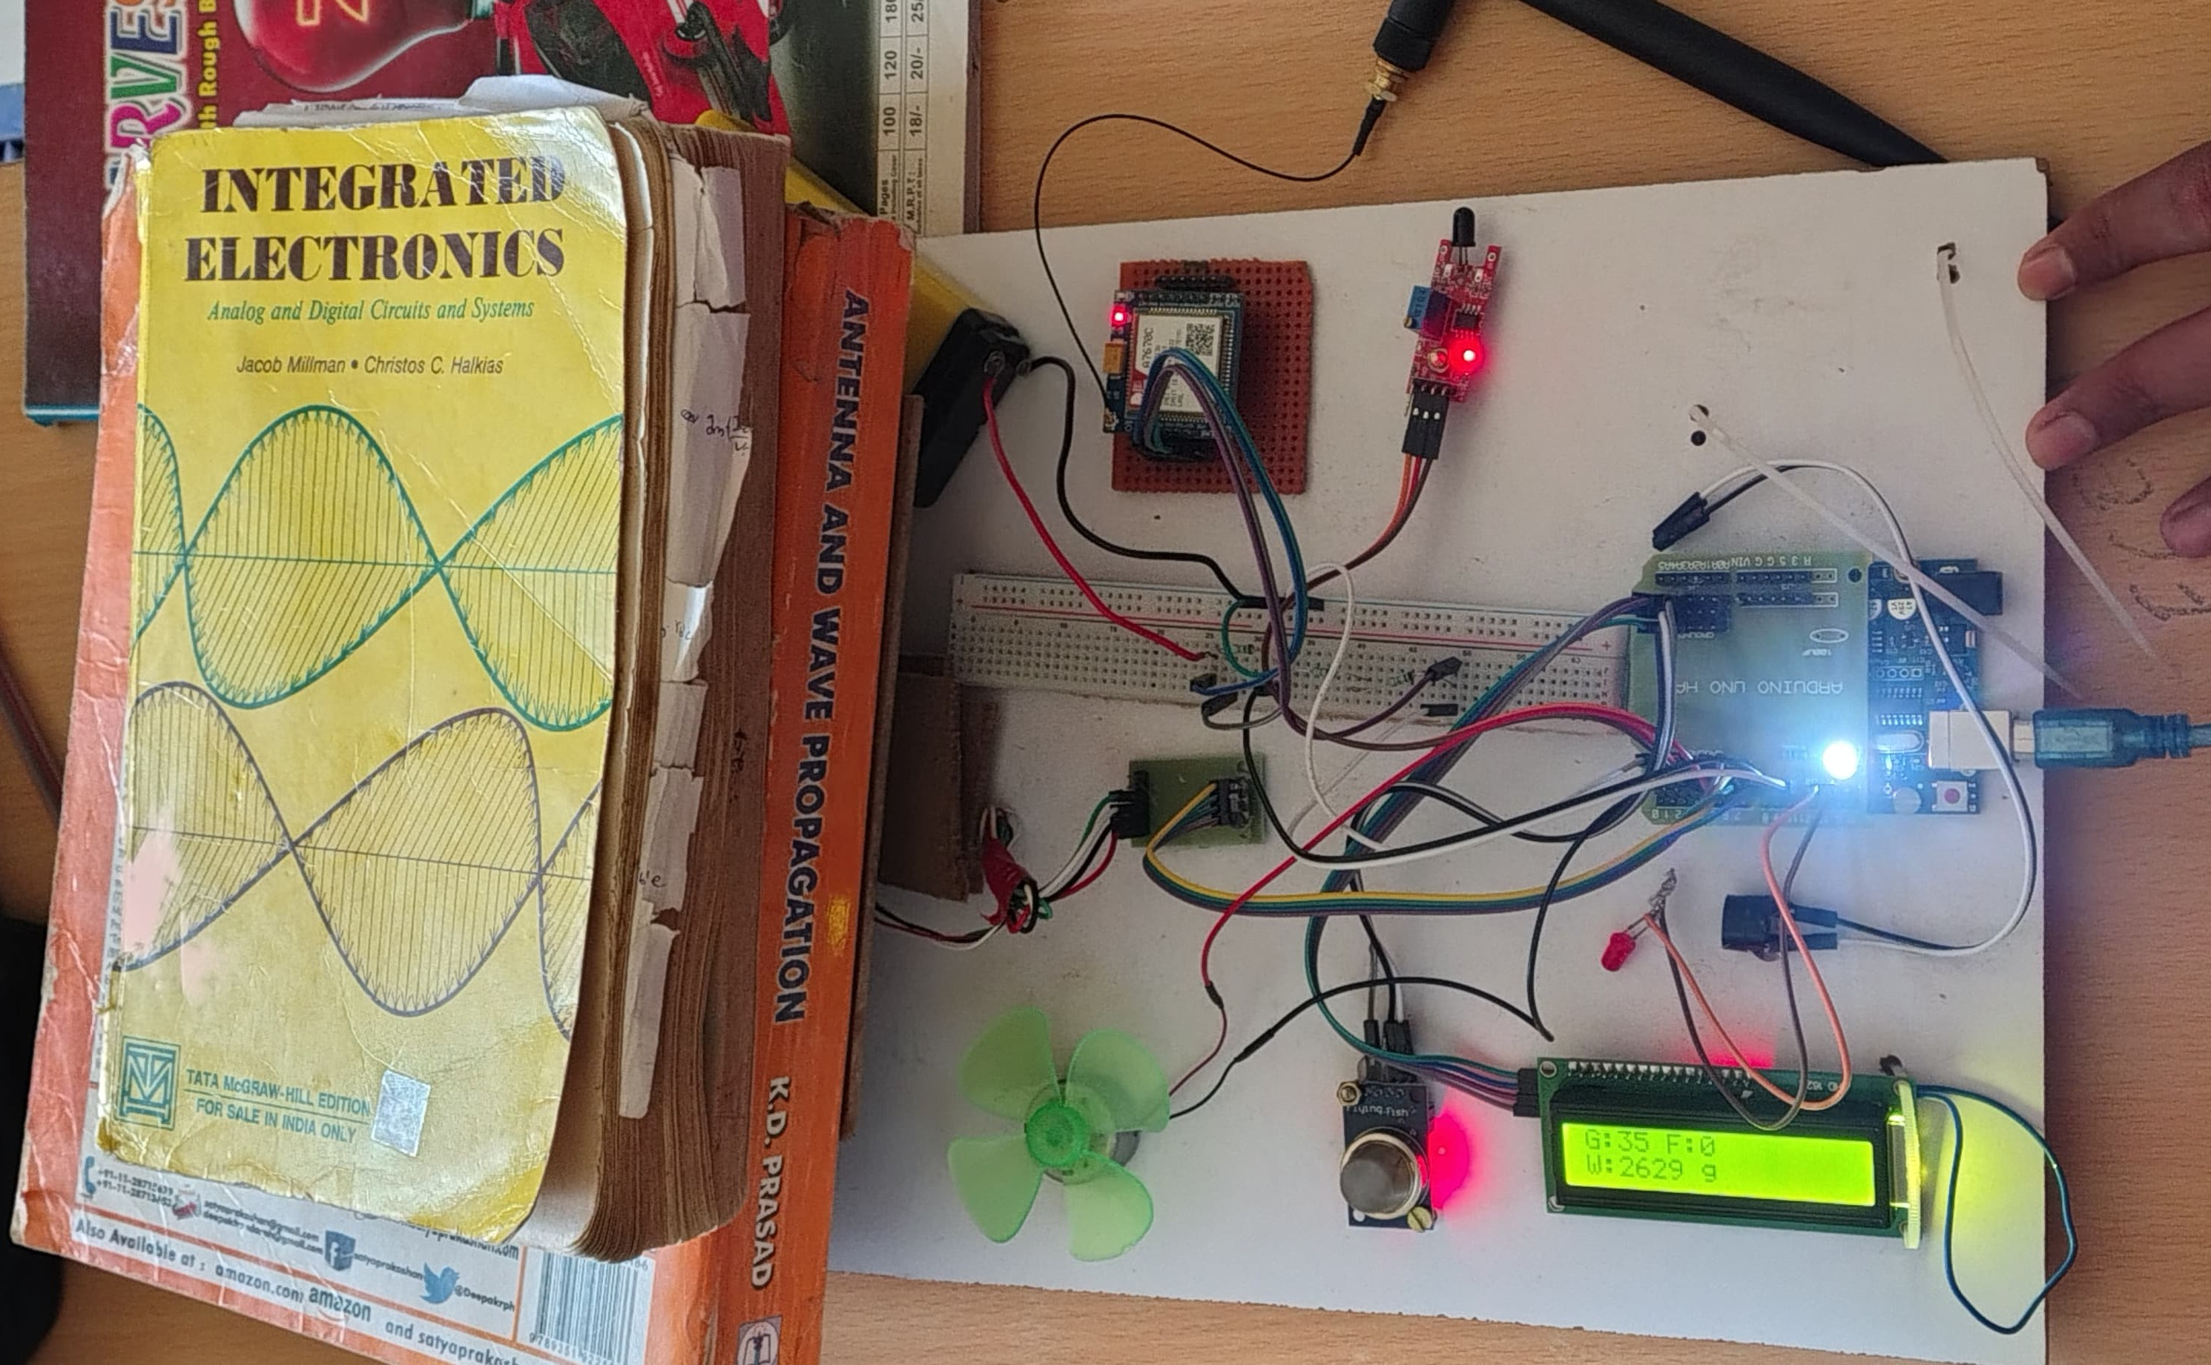
RESULT
Figure - Overview

Slide 18
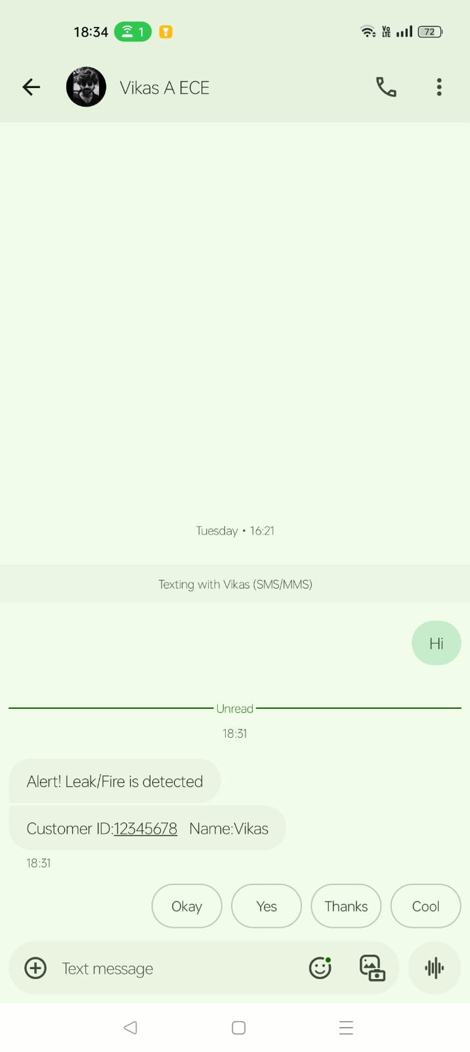
Result
→SMS(contains Customer ID and Name) was sent to gas booking agency when the gas level is below 200g.
→Alert was sent to mobile when the fire or the smoke is detected.
→When the fire is detected then the LED blinks.
→When smoke is detected then exhaust fan will on automatically and buzzer will turn on.

Slide 19
REFERENCES
S., Koushanfar, F., Kosterev, A., Tittel, F., “LASERSPECK’S: Laser spectroscopic Trace-Gas Sensor Networks - Sensor Integration and Applications”, Information Processing in Sensor Networks, 2007. IPSN 2007. 6th International Symposium on, April 2007, p. 226 - 235, ISBN 978-1-59593-638-7
P. M. Vidya, S. Abinaya, G. G. Rajeswari, and N. Guna, “Automatic Lpg leakage detection and hazard prevention for home security,” in Proceeding of 5th National Conference on VLSI, Embedded and Communication & Networks on April, vol. 7, 2014

Slide 20



